Slide 1
Ishikawa Diagram
Presented by:
Kush Muhamed
Balenzi phillip

Slide 2
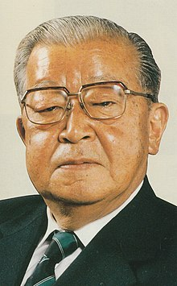
Background:
Fish borne diagram or herringbone diagram.
1920s & 1960s.
Kaoru Ishikawa

Slide 3
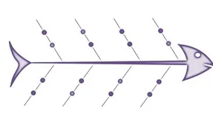
Illustration of the Ishikawa diagram:

Slide 4
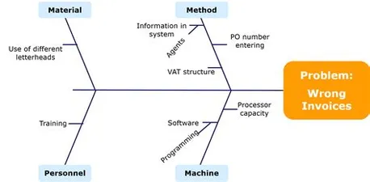
Example:
Industrial process(product design)
5Ms
4steps

Slide 5
Merits and demerits.
Merits | Demerits
Understandable | Doesn’t prioritize causes
It is applicable to complex & minor problems. | Highly relies on the brainstorming sessions.

